Slide 1

CHURN PREDICTION
Group- 9
Ashwin Kondapalli
Ishan Jain
Pragati Mishra
Vaibhav Shrivastava
Mobile

Slide 2

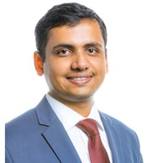


Pragati Mishra
CEO
Vaibhav Shrivastava
Business Analyst
Ishan Jain
Business Analyst
Ashwin Kondapalli
Business Analyst

Slide 3
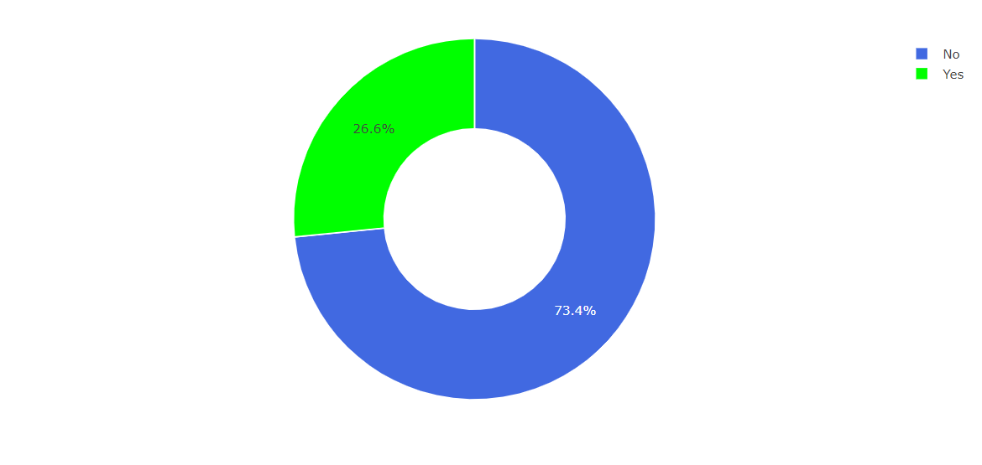
Customer churn rate
The churn rate is the percentage of subscribers to a service who discontinue their subscriptions to the service within a given time period.

Slide 4
Predictive Modeling Approach
1
2
3
4
Data Overview
Model Selection
Results
Conclusion

Slide 5
Customer Churn
Introduction: Service company often uses customer attrition analysis and customer attrition analysis and customer attrition rates as one of their key business metrics because the cost of retaining an existing customer is far less than acquiring a new one. Long term customers can be worth much more to a company than newly recruited clients.
There are two types of churn: voluntary churn and involuntary churn. Voluntary churn occurs due to a decision by the customer to switch another company or service provider, and Involuntary churn occurs due to circumstances such as customer’s relocation to a long-term care facility

Slide 6
What is in the data ?
Unique values :
customerID 7043
gender 2
SeniorCitizen 2
Partner 2
Dependents 2
tenure 73
PhoneService 2
MultipleLines 3
InternetService 3
OnlineSecurity 3
OnlineBackup 3
DeviceProtection 3
TechSupport 3
StreamingTV 3
StreamingMovies 3
Contract 3
PaperlessBilling 2
PaymentMethod 4
MonthlyCharges 1585
TotalCharges 6531
Churn 2
dtype: int64

Slide 7
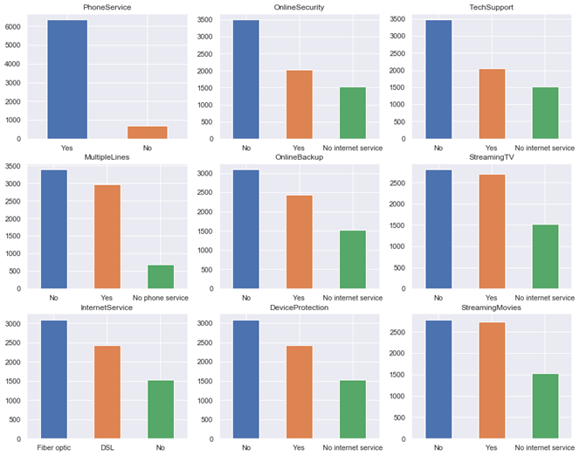
Services that each customer has signed up for
Phone Service
Online Security
Tech Support
Multiple Lines
Online Backup
Streaming TV
Internet Service
Device Protection
Streaming Movie
Notes:
Phone Service : Whether the customer has a phone service or not (Yes, No)
Multiple Lines: Whether the customer has multiple lines or not (Yes, No, No phone service)
Internet Service: Customer’s internet service provider (DSL, Fiber optic, No)
Online Security: Whether the customer has online security or not (Yes, No, No internet service)
Online Backup: Whether the customer has online backup or not (Yes, No, No internet service)
Device Protection: Whether the customer has device protection or not (Yes, No, No internet service)
Tech Support:Whether the customer has tech support or not (Yes, No, No internet service)
Streaming TV : Whether the customer has streaming TV or not (Yes, No, No internet service)
Streaming Movies : Whether the customer has streaming movies or not (Yes, No, No internet service

Slide 8
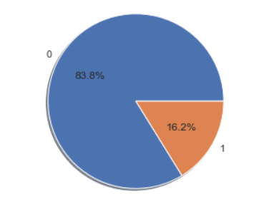
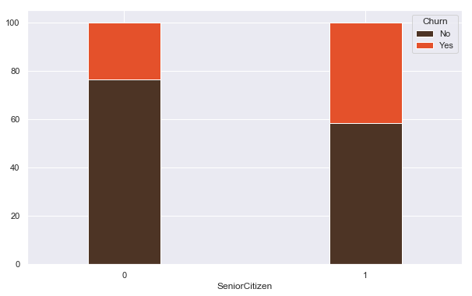
Frequency distribution of Senior Citizen
0- Young Citizen
1- Senior Citizen
Observation: Senior Citizen has more attrition rate.

Slide 9
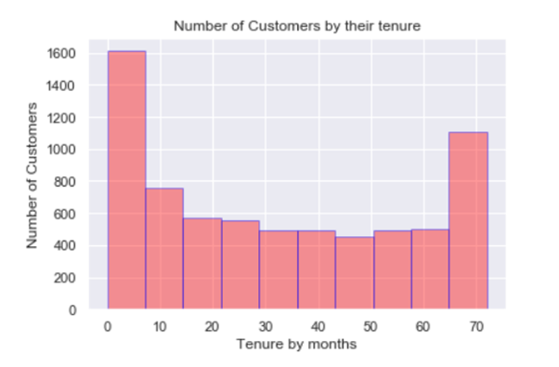
Number of Customers by their Tenure
Observation: After 10 months tenure, number of customer decreased.

Slide 10
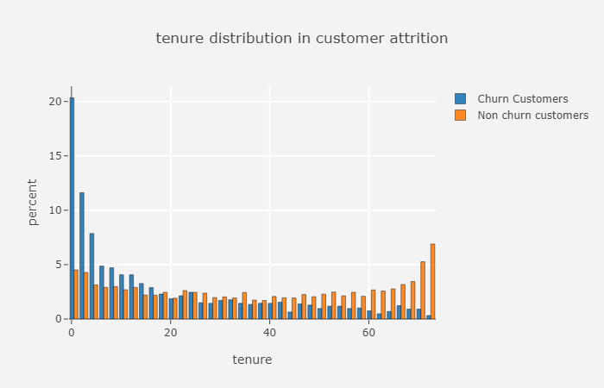
Distribution of Customers by their Tenure

Slide 11
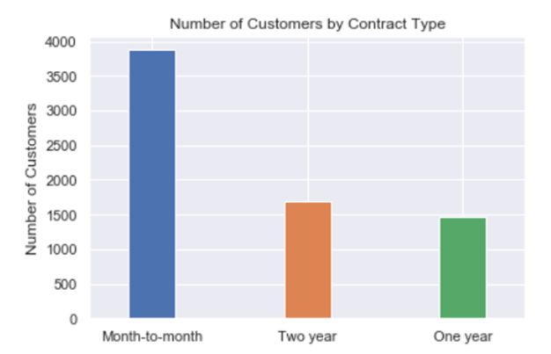
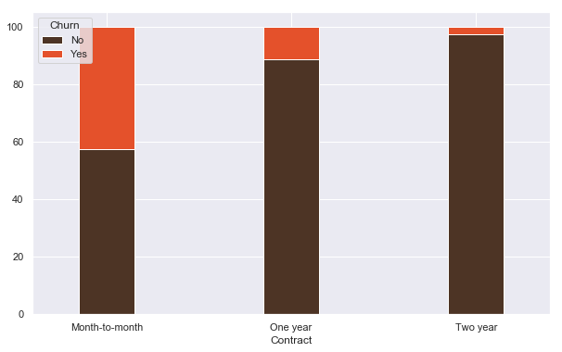
Number of Customers by Contract Type
Observation: Among the contract type, month-to-month contract type has highest attrition rate

Slide 12
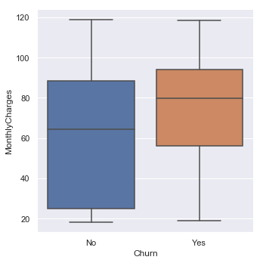
Monthly charges for Churn
Observation: Median of distribution of monthly charges for attrition is higher as compared to that of with no attrition.

Slide 13
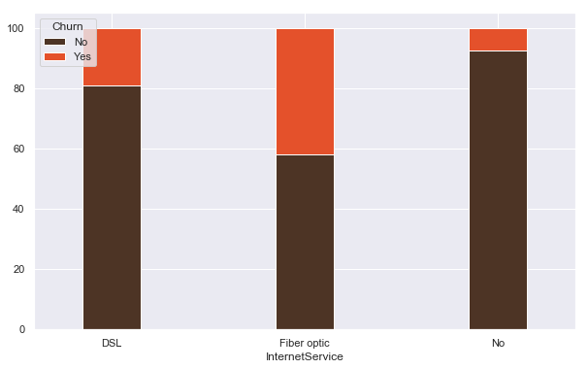
Fiber optic Internet Service with Churn rate
Observation: Fiber optic internet service has highest attrition rate.

Slide 14
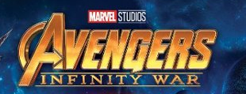
Summary of EDA
Senior citizen has higher churn rate
Churn rate is higher in initial period of tenure
Month-to month contract has highest churn rate
Fiber optics customer churn more frequently than other group customer.

Slide 15

Beginning of...

Slide 16
Predictive Modeling Approach
1
2
3
4
Data Overview
Model Selection
Results
Conclusion

Slide 17
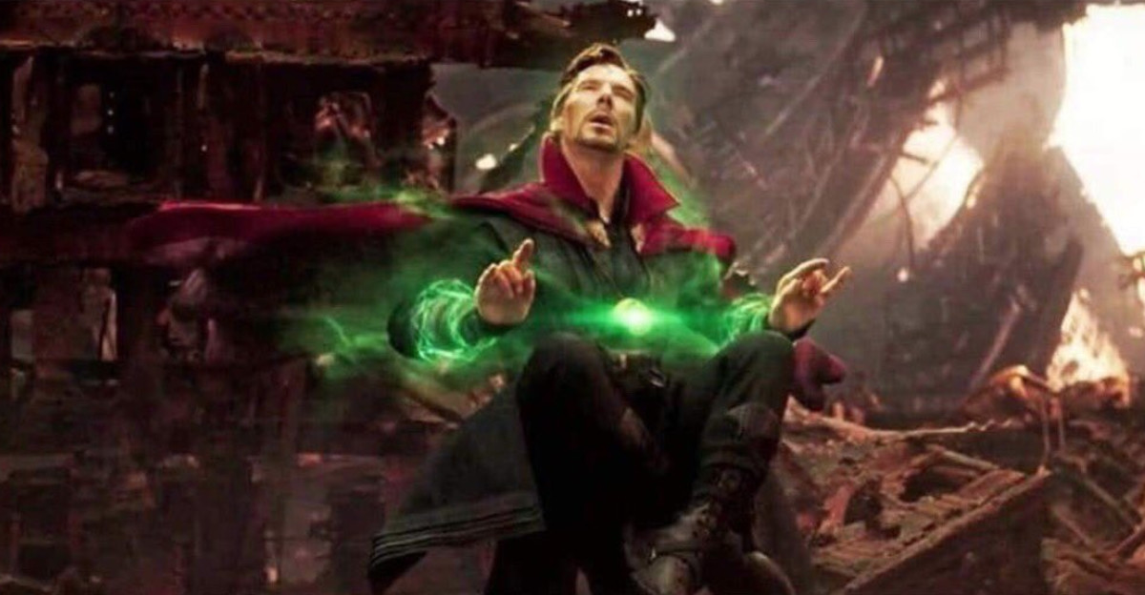
We have checked all possible outcomes, where we can solve the problem.

Slide 18

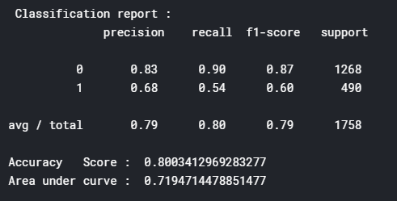
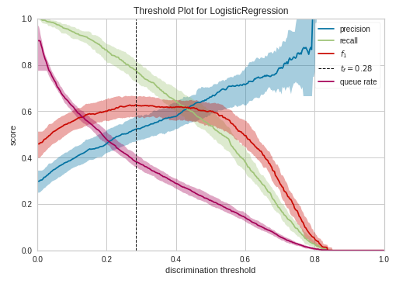
LOGISTIC REGRESSION
Time stone

Slide 19
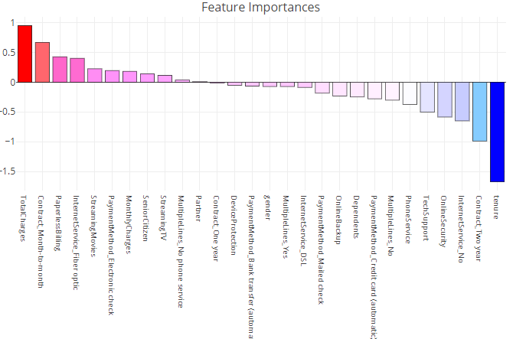
LOGISTIC REGRESSION

Slide 20
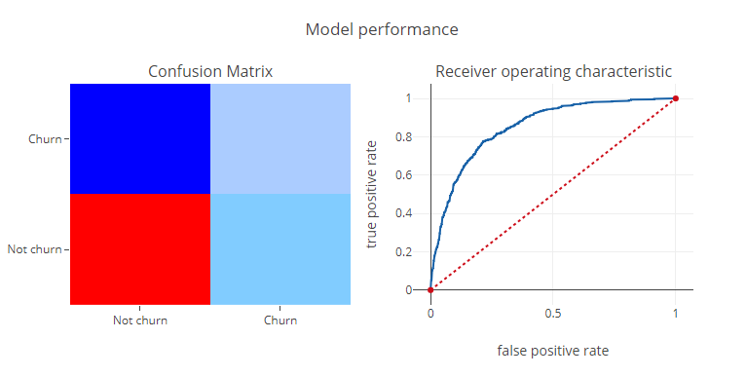
LOGISTIC REGRESSION
227
263
1144
124

Slide 21
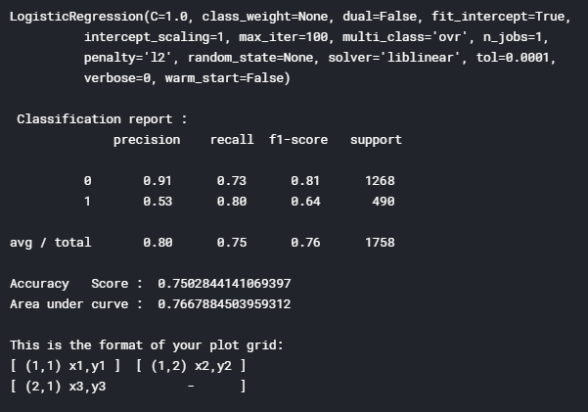
LOGISTIC REGRESSION (RFE)

Slide 22
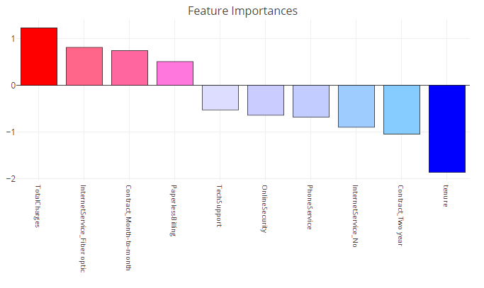
LOGISTIC REGRESSION (RFE)

Slide 23
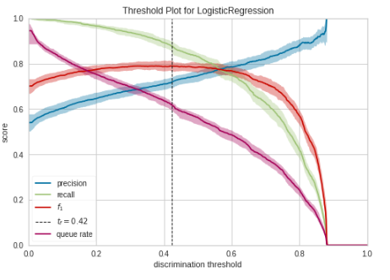
LOGISTIC REGRESSION (RFE)

Slide 24

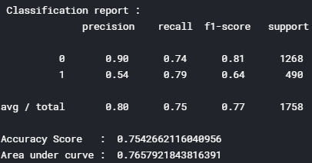
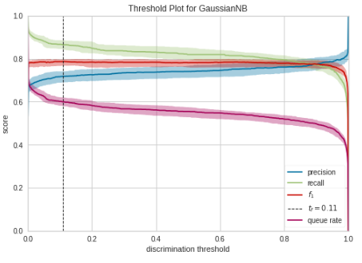
NAIVE BAYES CLASSIFIER
Mind Stone

Slide 25
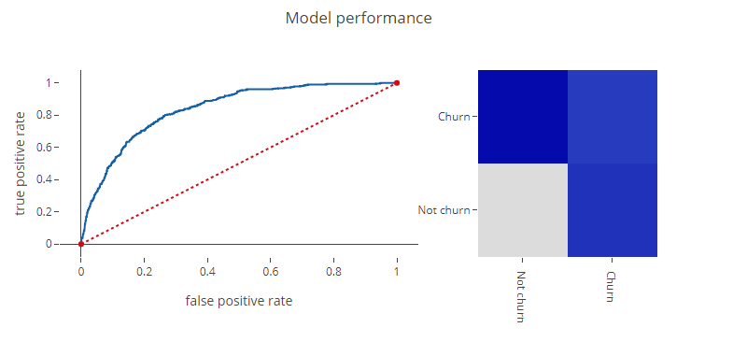
NAIVE BAYES CLASSIFIER
102
388
938
330

Slide 26

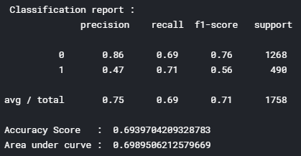
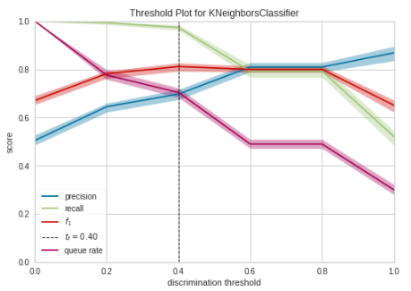
KNN CLASSIFIER
Soul Stone

Slide 27
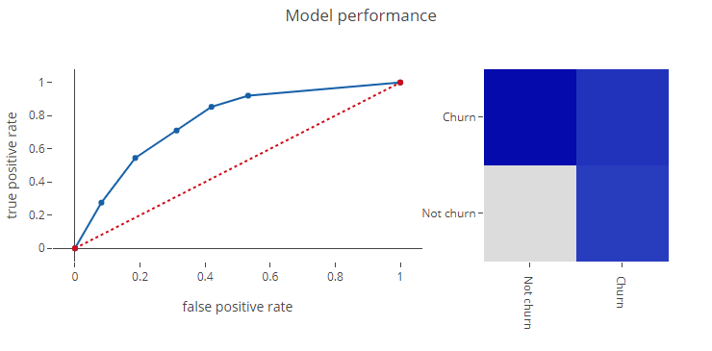
KNN CLASSIFIER
142
348
872
396

Slide 28

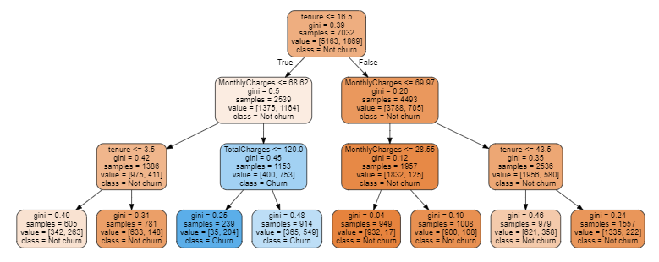
DECISION TREES
Reality Stone

Slide 29
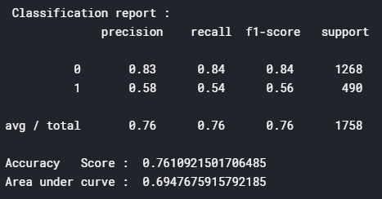
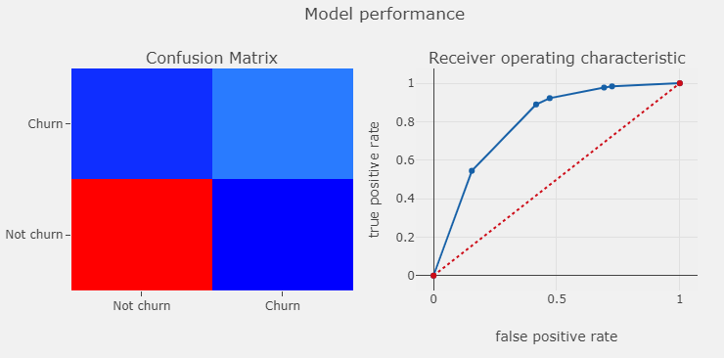
DECISION TREES
223
267
1071
197

Slide 30

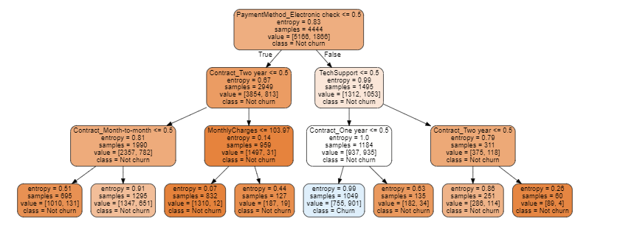
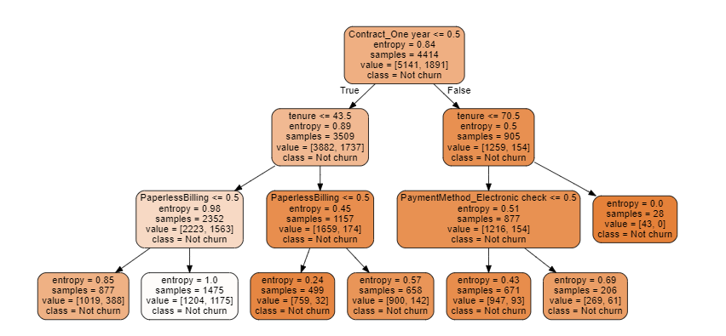
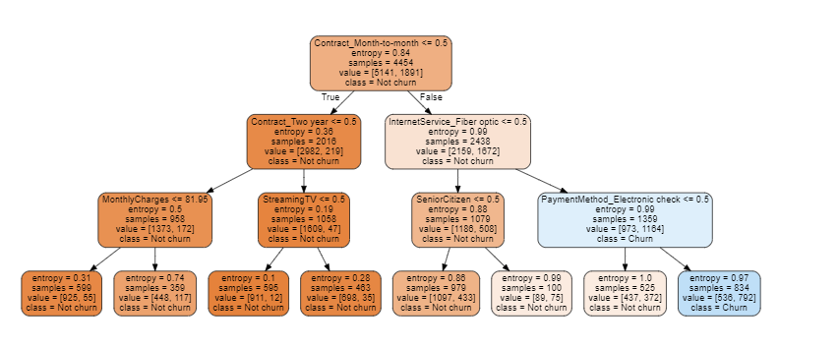
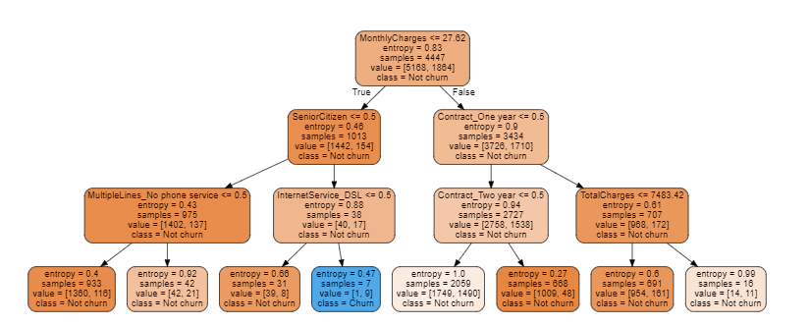
RANDOM FOREST CLASSIFIER
Space Stone

Slide 31
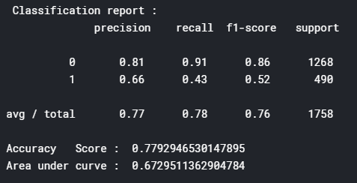
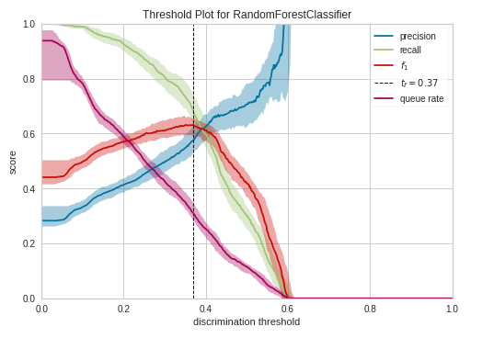
RANDOM FOREST CLASSIFIER

Slide 32
RANDOM FOREST CLASSIFIER
102
388
938
330

Slide 33
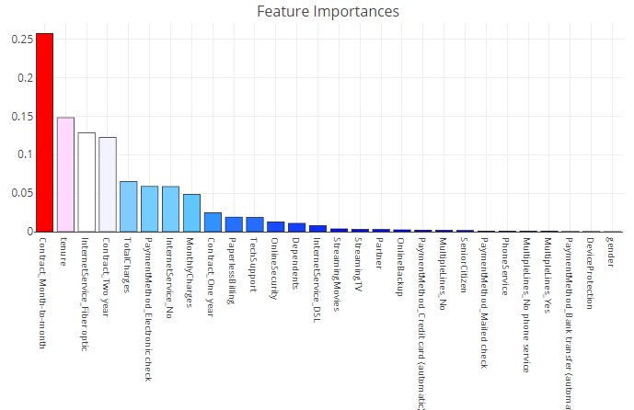
RANDOM FOREST CLASSIFIER

Slide 34

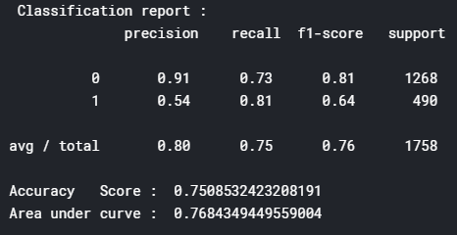
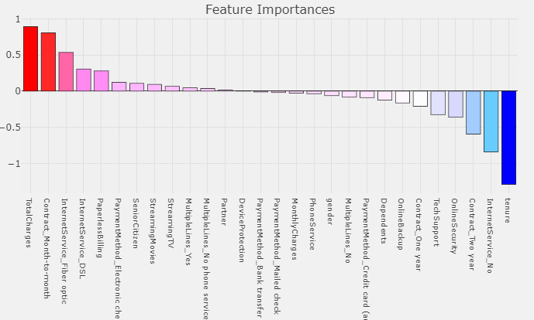
SUPPORT VECTOR MACHINE
Power Stone

Slide 35
SUPPORT VECTOR MACHINE
94
396
924
344

Slide 36
Predictive Modeling Approach
1
2
3
4
Data Overview
Model Selection
Results
Conclusion

Slide 37
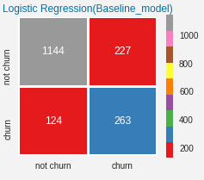
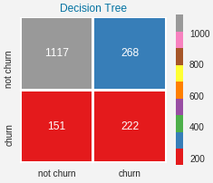
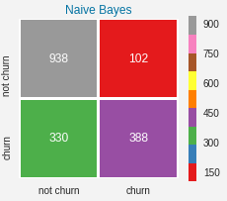
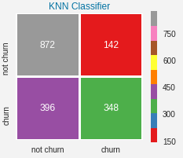
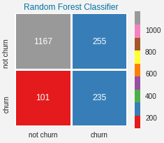
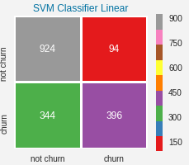
CONFUSION MATRIX COMPARISON

Slide 38
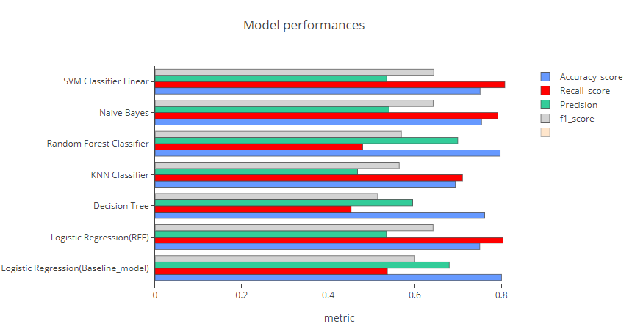
COMPARISON OF MODEL PERFORMANCES

Slide 39
Predictive Modeling Approach
1
2
3
4
Data Overview
Model Selection
Results
Conclusion

Slide 40

FINAL RECOMMENDATIONS
Target new customers with 1 year or 2 year contracts with special incentives.
Pitch special bundle package offers to new customers in order to minimize future chance of churn.
Minimize total charges levied on customers with less tenure.
Offer high discount packages to customers most likely to churn as of today.

Slide 41

THANKS!
Any questions?
You can find us at @utd

